Slide 1
DISTRIBUTION TRANSFORMER MAGNETIC OIL FAULT MONITORING

Slide 2
Introduction & Overview
Distribution transformers are a critical component of electrical power distribution systems, responsible for stepping down high-voltage transmission-level electricity to the lower voltages used in residential and commercial applications. These transformers often operate in harsh environments and are subject to various faults and failures that can disrupt power delivery.
One common fault in distribution transformers is the magnetic fault in the oil gauge. The oil gauge is a vital component that monitors the level and condition of the transformer's insulating oil, which is crucial for the transformer's proper functioning and longevity. Magnetic faults in the oil gauge can lead to inaccurate readings, potentially causing issues with transformer maintenance and operation.

Slide 3
Project Statement
Utilizing machine learning techniques, this project aims to develop predictive models for detecting magnetic faults in oil gauges of distribution transformers. Leveraging data collected from IoT devices between June 25th, 2019, and April 14th, 2020, with readings every 15 minutes, the objective is to anticipate potential issues in advance, enabling proactive maintenance strategies and ensuring the reliable operation of electrical power distribution systems

Slide 4
Methodology
Our proposed methodology involves exploring various machine learning algorithms to develop predictive models for detecting magnetic faults in distribution transformers' oil gauges. Initially, we experiment with different methods, including but not limited to decision trees, random forests, support vector machines, and adaboost classifier . Each method is evaluated based on its accuracy in predicting faults using the collected IoT data.
Following extensive experimentation and evaluation, we select the model with the highest accuracy for further refinement and optimization. This model demonstrates superior performance in identifying the onset of magnetic faults in oil gauges, offering promising results for proactive maintenance strategies.

Slide 5
Data Collection
The data was collected from June 25th, 2019 to April 14th, 2020 via IoT devices, with readings taken every 15 minutes. The data is contained in two CSV files: "Overview.csv" and "CurrentVoltage.csv". The two dataframes were merged on the "DeviceTimeStamp" column.
This dataset was originally collected from Kaggle at the following URL: https://www.kaggle.com/datasets/sreshta140/ai-transformer-monitoring

Slide 6
Data Analysis
The features in the data include:-
1. OTI - Oil Temperature Indicator
2. WTI - Winding Temperature Indicator
3. ATI - Ambient Temperature Indicator
4. OLI - Oil Level Indicator
5. OIT - Oil Temperature Indicator Trip
7.VL1, VL2, VL3 - Phase Line 1,2,3 voltages
8. IL1, IL2, IL3 - Current Line 1,2,3
9. VL12, VL23, VL31 - Voltage Line 1 to 2, 2 to 3, 3 to 1 phases 10. INUT - Neutral Current

Slide 7
Code part
We use the MOG_A feature as the output variable. The data was split into 80% training and 20% testing sets for building a machine learning model.
Google colab link:
mlproject.ipynb - Colab (google.com)

Slide 8
Result
After conducting experiments using various machine learning algorithms on the dataset collected from IoT devices, we obtained the following accuracies for predicting magnetic faults in distribution transformers' oil gauges:
Decision Tree: 98.44%
AdaBoost Classifier: 97.83%
Random Forest: 98.85%
Support Vector Machine (SVM): 95.77%
Logistic Regression: 94.28%

Slide 9
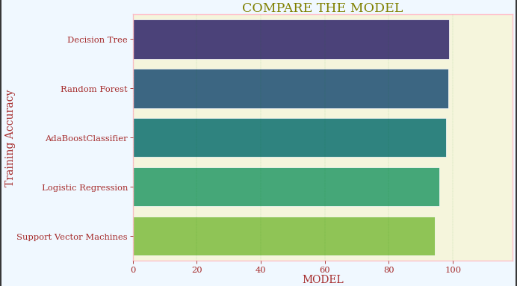
Among these models, the Random Forest algorithm demonstrated the highest accuracy of 98.85%. Consequently, we selected the Random Forest model as the most effective approach for predicting magnetic faults in oil gauges. This high accuracy suggests that the Random Forest model is well-suited for identifying potential issues in distribution transformers and enabling proactive maintenance strategies.

Slide 10
Conclusion
In conclusion, our study assessed machine learning algorithms for predicting magnetic faults in distribution transformers' oil gauges. The Random Forest model yielded the highest accuracy at 98.85%, offering reliable fault detection. This underscores its suitability for proactive maintenance, ensuring uninterrupted power distribution. Our findings highlight the significance of advanced algorithms in infrastructure management. Future endeavors could refine models and integrate real-time monitoring. Overall, our research enhances predictive maintenance strategies, fostering resilience and efficiency in electrical power distribution systems.

Slide 11
THANK YOU

